Slide 1
LARAVEL

Slide 2
Introduction to Laravel
Laravel is a free and open-source PHP-based web framework for building web applications.
It was created by Taylor Otwell.
It follows a model-view-controller design pattern.
Laravel's fundamental concepts include Routing, Views, Eloquent ORM, Controllers, Models & Migrations, Requests, and Responses.
An alternative to CakePHP and CodeIgniter

Slide 3
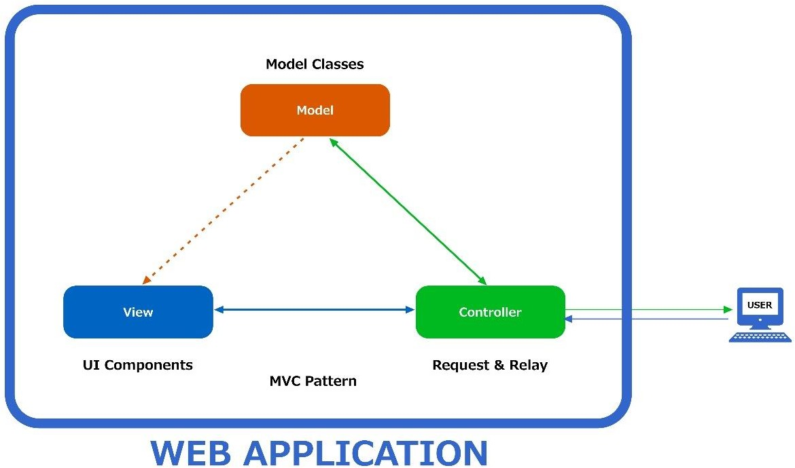
What is mvc?
MVC Architecture

Slide 4
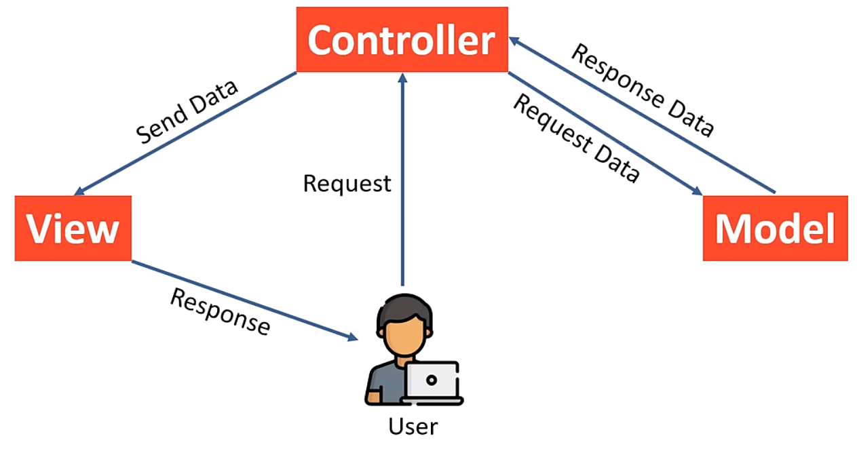
What is mvc model?
Laravel Framework

Slide 5
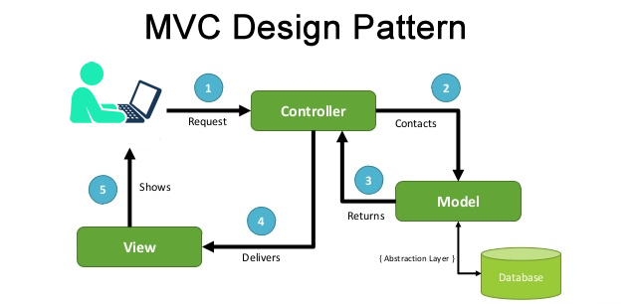
How does MVC works?

Slide 6

SETTING UP THE ENVIRONMENT
List of components
PHP
Composer
VS Code

Slide 7
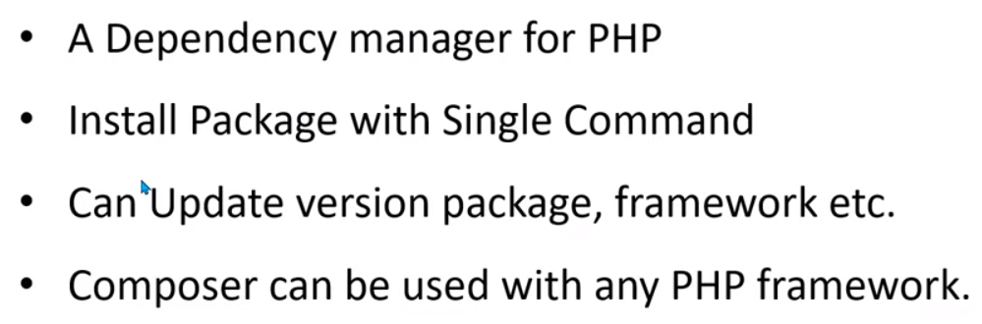
What is composer?

Slide 8
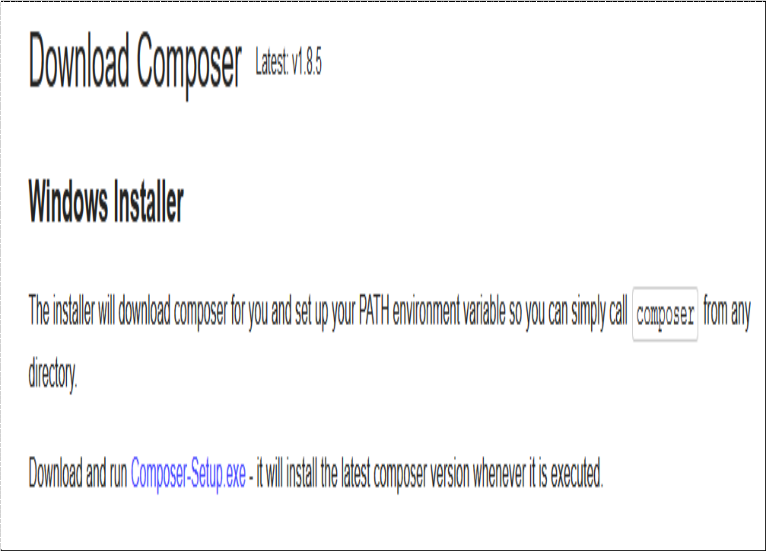
SETTING UP COMPOSER

Slide 9
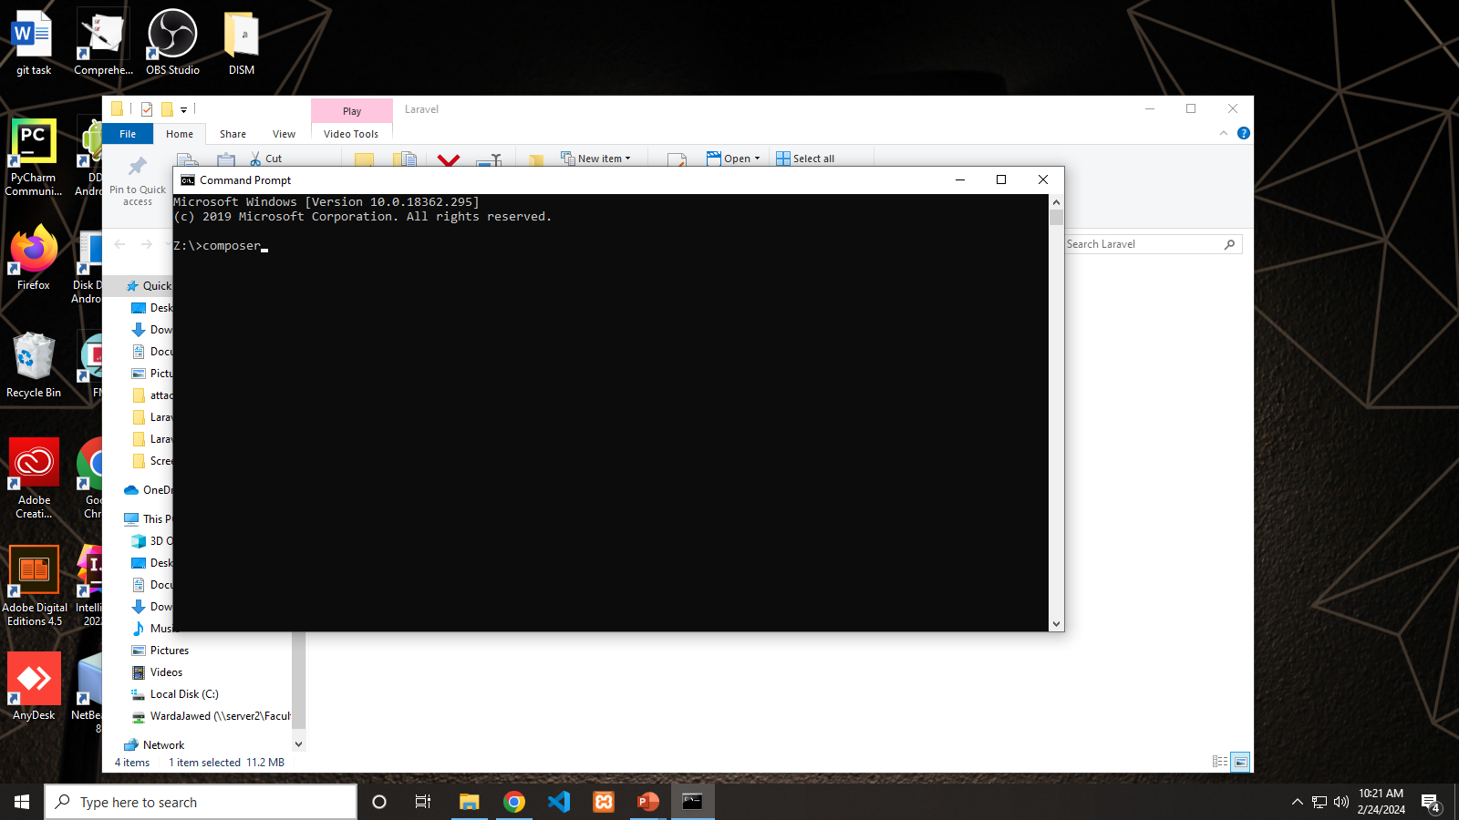
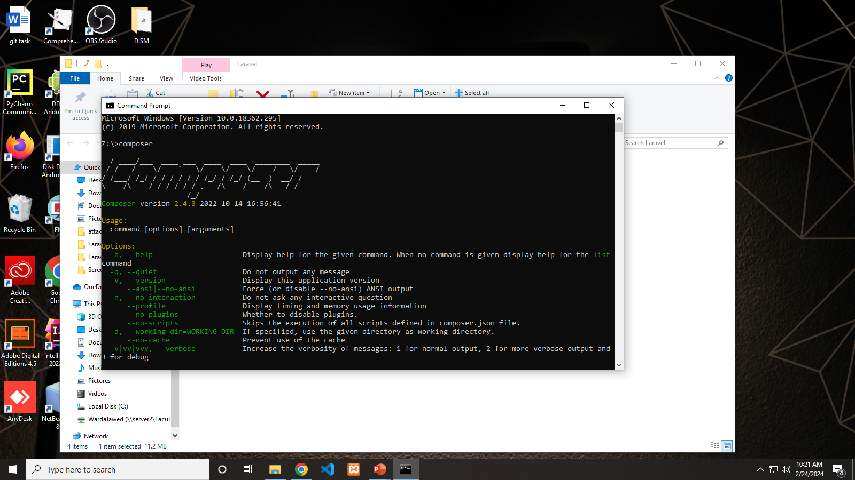
Checking all required components

Slide 10
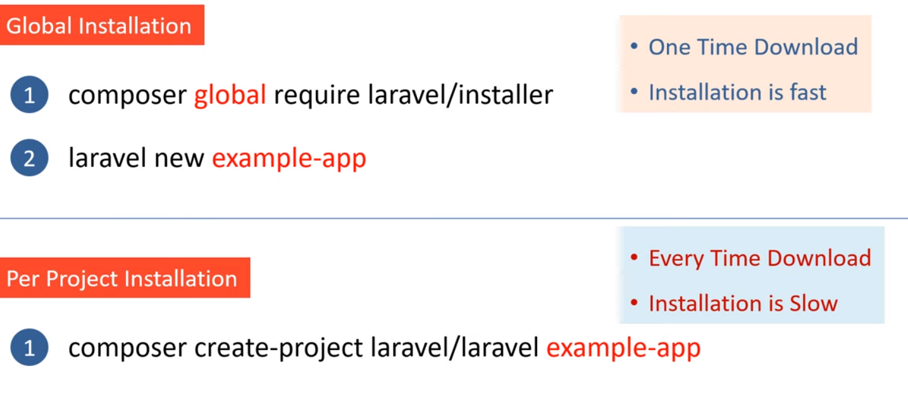
Installing Laravel using composer

Slide 11
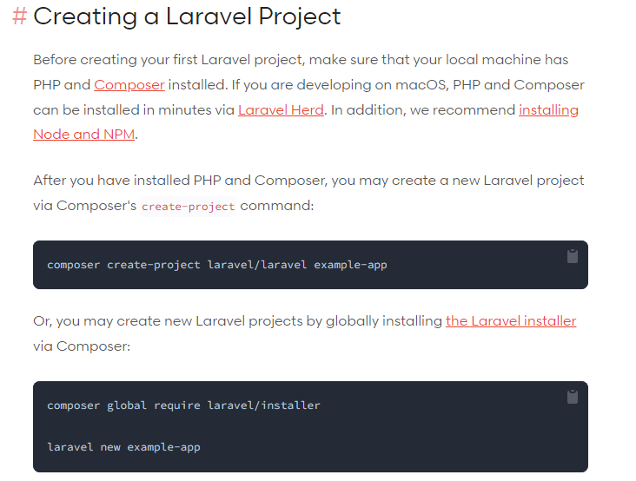
Installing Laravel using composer
https://laravel.com/docs/10.x
Go to this link

Slide 12
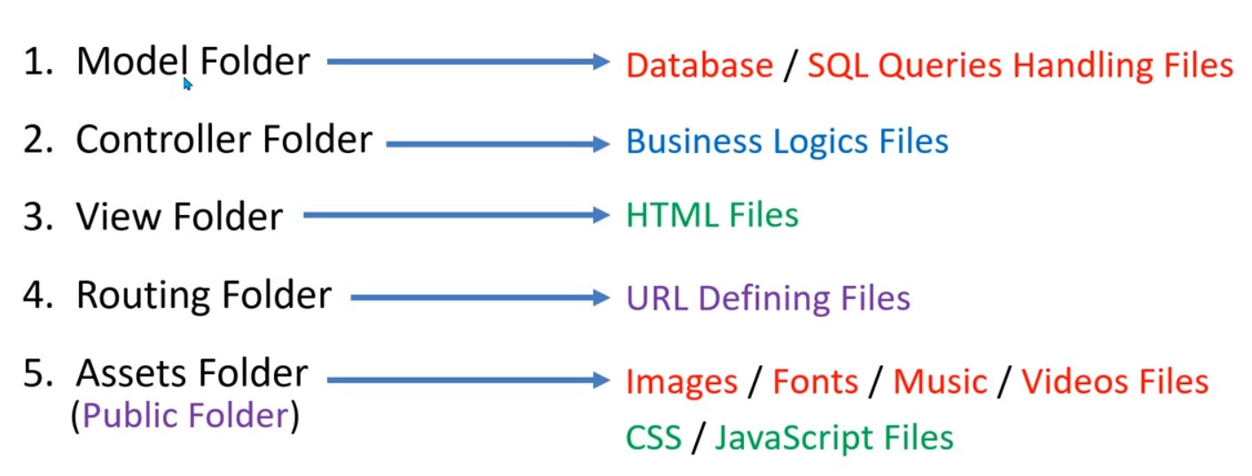
Laravel file & folder structure

Slide 13
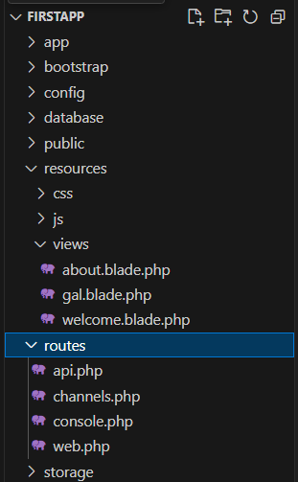
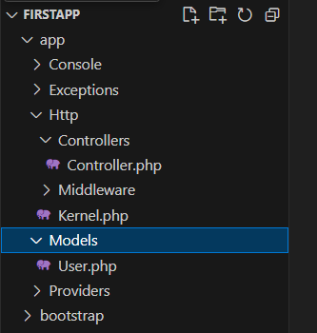
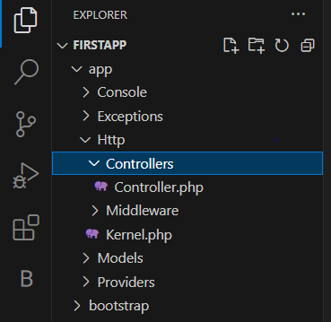
Laravel file & folder structure
VIEW
CONTROLLER
MODEL

Slide 14
Views
Provides the modularity required for Web application development.
Located at resources\views
Separates the controller/application logic from the presentation logic.
VIEW

Slide 15
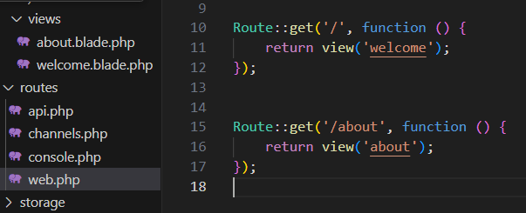
View and route folder

Slide 16
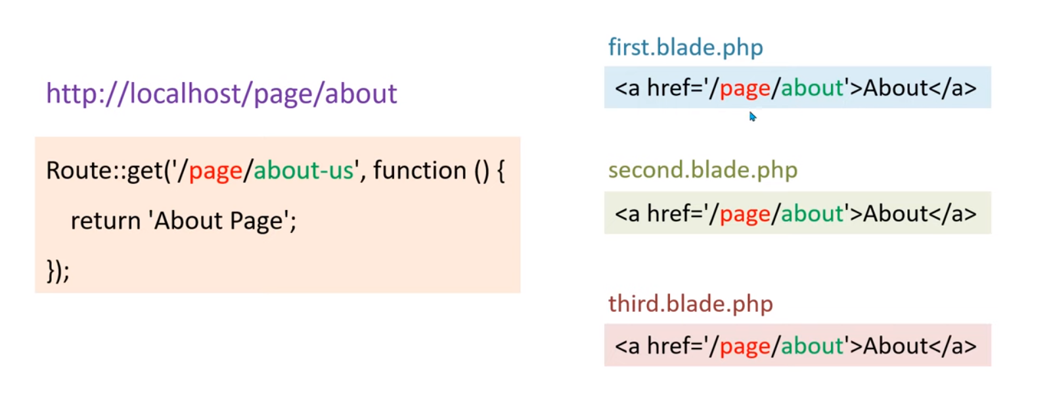
Named route

Slide 17
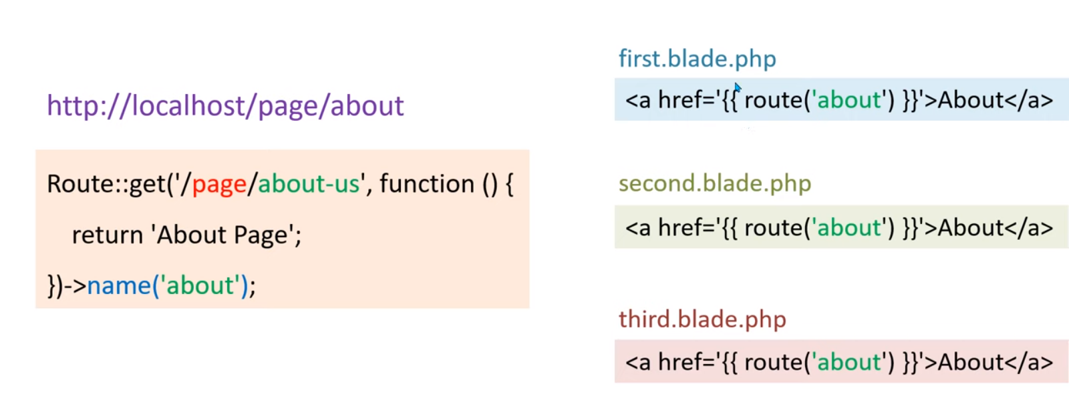
Named route

Slide 18
Blade Template
Blade Template
Template Engine based on PHP
Blade provides a clean and convenient way to create views in Laravel
Benefits: Create Dynamic and Reusable Templates
HTML, PHP

Slide 19
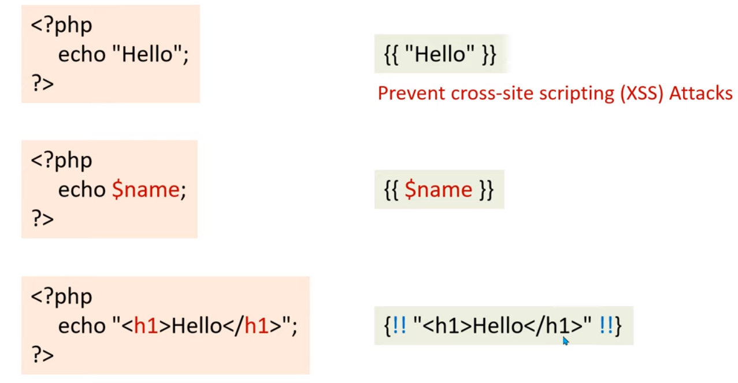
BLADE Template syntax

Slide 20
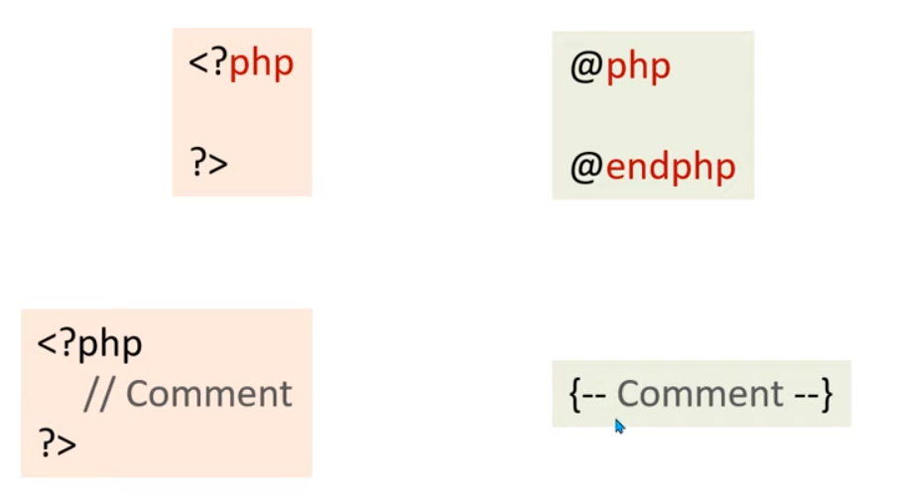
BLADE Template syntax

Slide 21
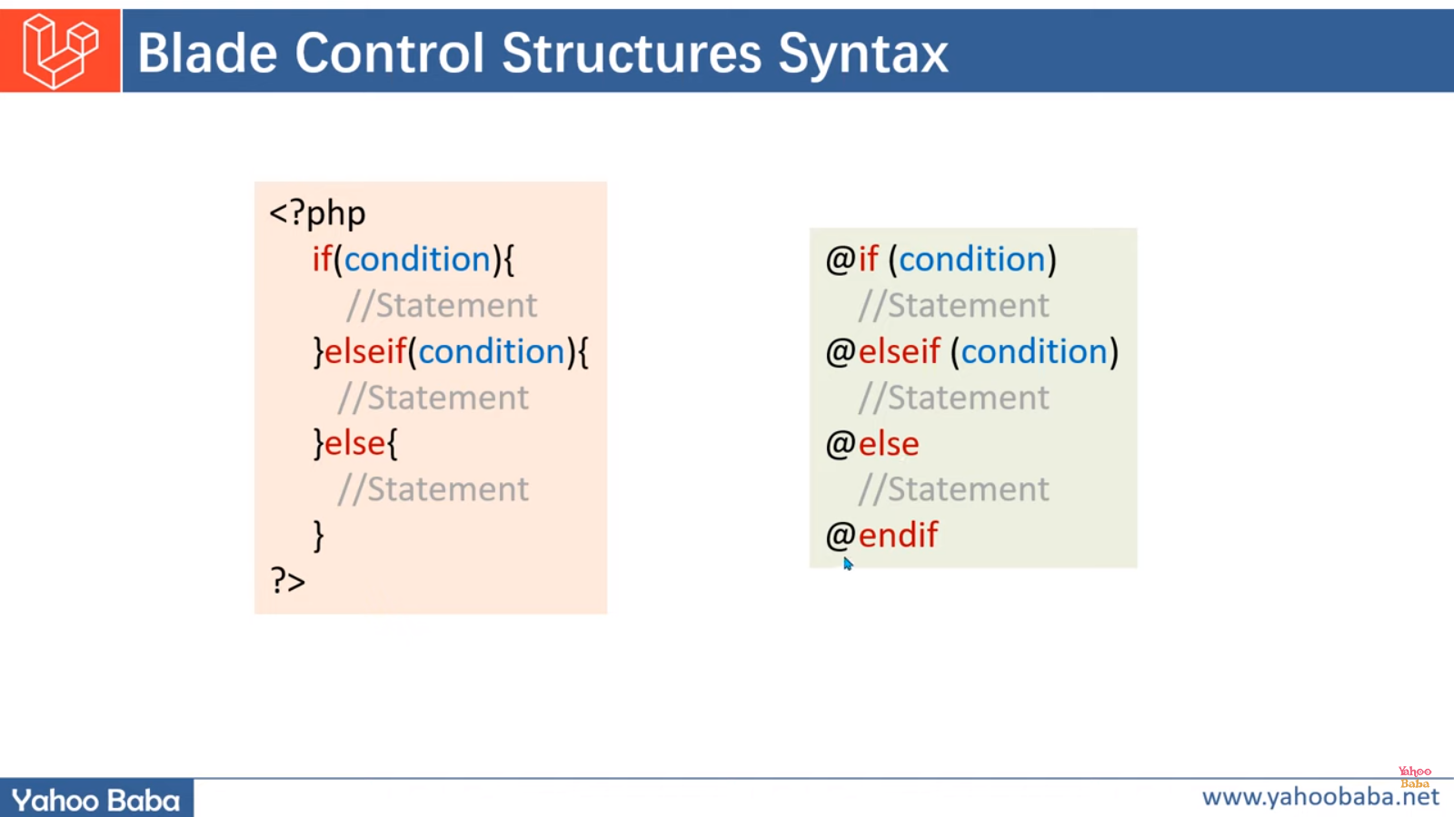
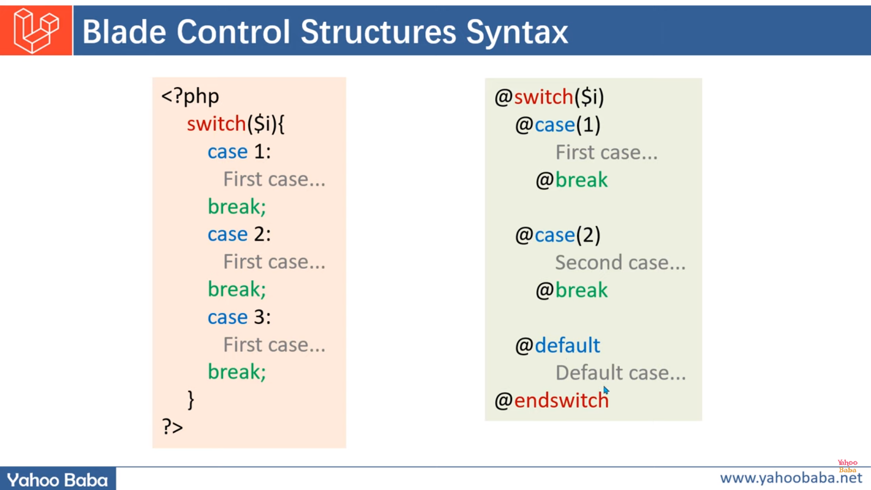
BLADE Template syntax

Slide 22
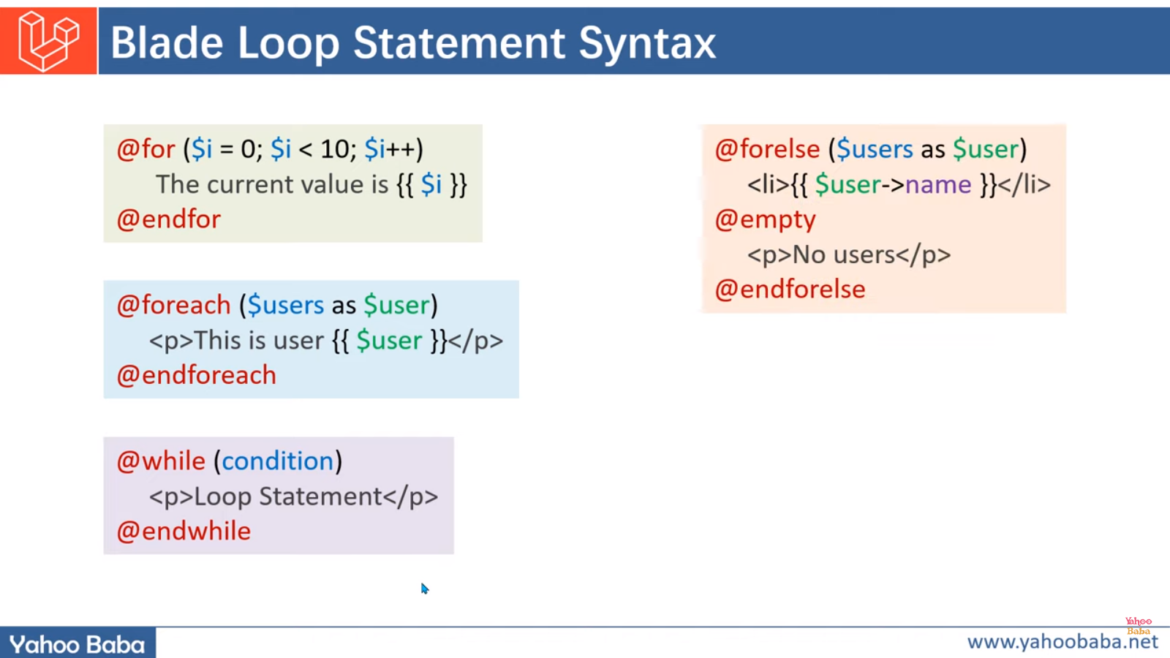
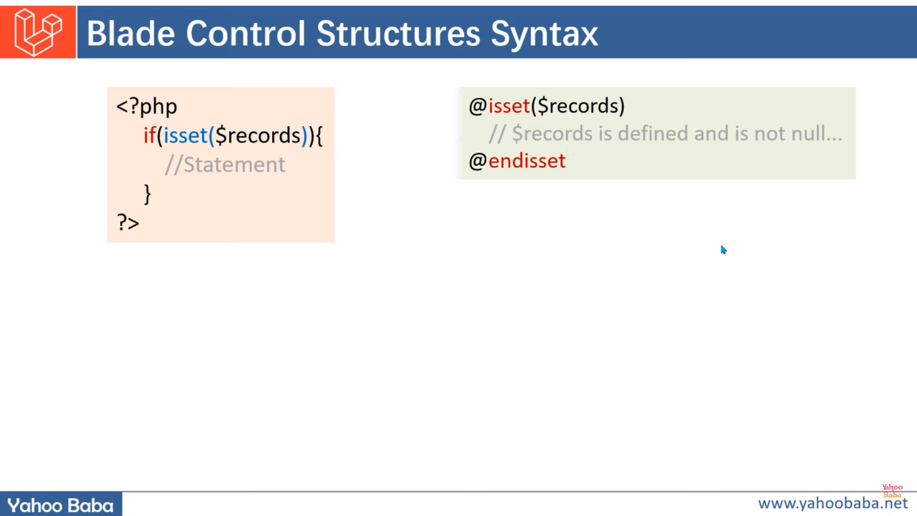
BLADE Template syntax

Slide 23
Blade Temp-late main directives
@include
@extends
@yield
@section

Slide 24
How to create Database using PhpMyAdmin / MySQL
Rename the database inside .env file
Run Php artisan migrate
Create Migrations:
php artisan make:migration create_students_table
Create Model:
php artisan make:model students
Create Controller:
php artisan make:controller StudentsController
Make migration along-with model class
php artisan make:model students –m
Make migration along-with model class and controller
php artisan make:model students -m –c
@csrf (Cross Site Request Forgery)

Slide 25
For User Authentication:
Rename the database inside .env file
.ENV stands for (environment specific variables for the app)
Php artisan migrate
For user authentication (login/signup) run the following commands
composer require laravel/ui
php artisan ui bootstrap --auth
npm install (agar nodejs installed nai hoga to ye run nai hoga!)
npm run dev
npm run development OR npm run build
php artisan serve

